Slide 1
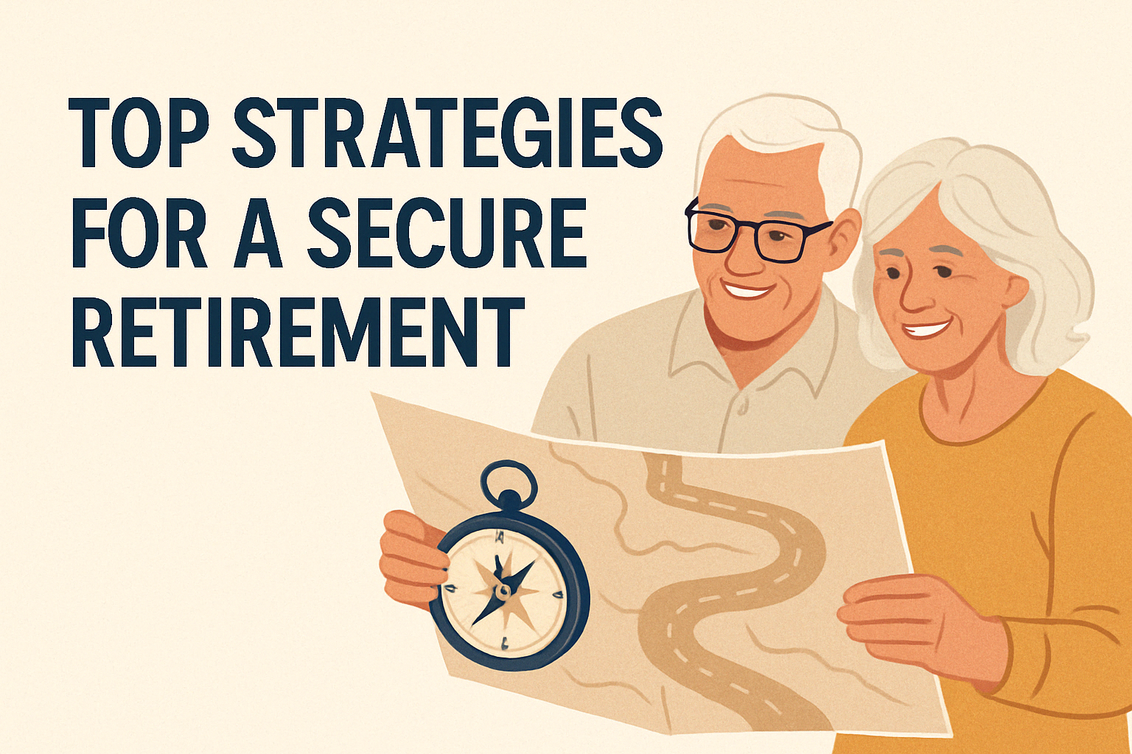
Top Strategies for a
Secure Retirement
A Great Pathways Presentation

Slide 2
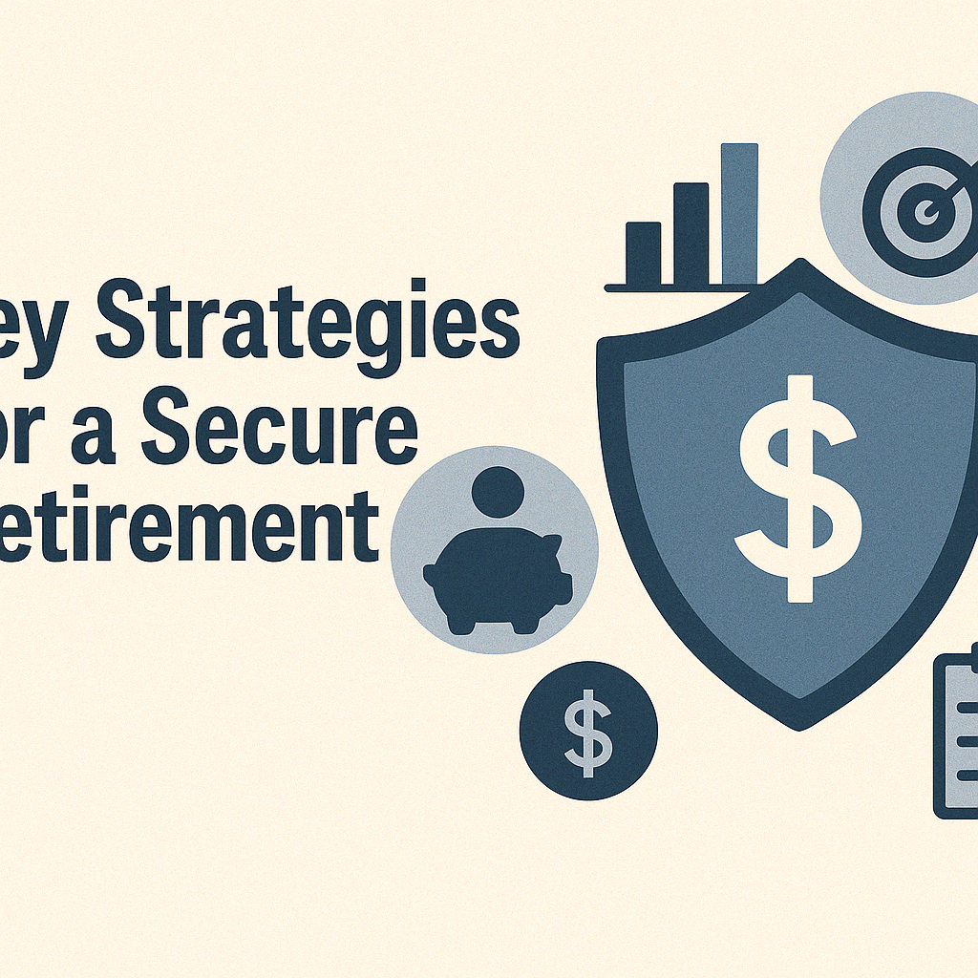
Welcome to
"Top Strategies for a Secure Retirement"
Notes:
Welcome to our webinar on the top strategies for achieving a secure and fulfilling retirement. I'm Tarlie Francis, and I'm excited to guide you through this journey to financial peace of mind; now and, especially, in preparation for your golden years.

Slide 3
IWhy Retirement Planning Matters
Importance of Planning for Retirement
Notes:
Retirement planning is crucial for ensuring that you can maintain your desired lifestyle and achieve your goals during your golden years. Proper planning helps you navigate uncertainties and provides financial security.

Slide 4
Setting Clear Retirement Goals
Define Your Retirement Vision
Notes:
The first step in retirement planning is setting clear goals. What do you envision for your retirement? Travel, hobbies, spending time with family? Defining your vision helps shape your financial strategy.

Slide 5
Building a Robust Financial Plan
Crafting
Your
Financial
Strategy
Notes:
A robust financial plan is the cornerstone of a secure retirement. This includes budgeting, maximizing retirement contributions, and diversifying investments to align with your goals and risk tolerance.

Slide 6
Understanding Investment Options
Explore Investment Opportunities
Notes:
Understanding your investment options is vital. Stocks, bonds, mutual funds, and real estate each offer unique benefits. Diversifying your portfolio helps mitigate risk and maximize returns.

Slide 7
Leave a Lasting Impact
Creating
A
Legacy
Notes:
Many people wish to leave a legacy for their loved ones. Estate planning, including wills and trusts, helps you manage your assets and ensure your wishes are honored.

Slide 8
"The best way to predict the future is to create it."
- Peter Drucker
Notes:
As we approach the conclusion of our webinar, I want to leave you with a thought-provoking quote by Peter Drucker: "The best way to predict the future is to create it. This quote encapsulates the essence of retirement planning. By taking proactive steps today, you have the power to shape your financial future and ensure a fulfilling retirement. Remember, the decisions you make now will pave the way for the life you desire in your golden years.

Slide 9
Notes:
Let’s soak it in

Slide 10
Ready to Secure Your Retirement?
Notes:
Are you ready to take control of your retirement planning? Contact Great Pathways team for personalized coaching and guidance tailored to your unique needs. Let's work together to create a secure and joyful retirement.

Slide 11
Thanks!
https://www.great-pathways.com/
Contact us:
Great Pathways
tf@tarliefrancis.com
www.great-pathways.com
Notes:
Thank you for joining our webinar on achieving retirement joy through financial coaching. We hope you found the insights valuable and inspiring. Click the “Free Financial Consultation” button on our website linked above to schedule your personalized consultation and take the next step towards a secure and fulfilling retirement. We look forward to assisting you on your journey.

